Slide 1

COMPANY PROFILE · 2026
Patient Capital.
Curated Access.
One Platform.
PMS, AIF & GIFT City investments — curated for investors who think in decades.
AMFI
APMI
45+ PMS
30+
ARN-335497
APRN-06567
Strategies
Partners
www.kalviroventures.com
Kalviro Ventures · PMS, AIF & GIFT City
1 / 10

Slide 2
THE LANDSCAPE
India has everything.
What's rare is curation.
01
The universe has expanded.
45+ PMS strategies, 1,000+ AIF schemes, and GIFT City vehicles. The challenge is no longer access — it is signal.
02
Most relationships are transactional.
Recommendations are often calibrated to what is available — not what belongs in your portfolio.
03
Accountability is diffuse.
PMS, AIFs and GIFT City often sit across separate relationships. No one owns the full picture.
Kalviro Ventures · PMS, AIF & GIFT City
2 / 10

Slide 3
ABOUT US
Who We Are
Registration
Kalviro Ventures is an AMFI- and APMI-registered platform for patient capital. Curated access to PMS, AIF, and GIFT City — fewer opportunities, higher conviction, one accountable relationship.
AMFI ARN-335497 · APMI APRN-06567
Focus
PMS · AIF · GIFT City
Clientele
THE NAME
HNI · UHNI · NRI · Family Offices
Kalviro = Kalpavriksha (enduring abundance) + Viro (strength). Capital built on fundamentals and selective judgment outlasts capital built on market timing.
Approach
Conviction-led. Fewer strategies.
Recognition
Startup India · MSME
“Would we allocate our own capital here?”
If no — it never reaches your dashboard.
Base
Chennai, India
Kalviro Ventures · PMS, AIF & GIFT City
3 / 10

Slide 4
INVESTMENT ACCESS
Three Focus Areas. One Relationship.
01
02
03
PMS
AIF
GIFT City
High-conviction equity by SEBI-registered managers. Direct stock ownership in your demat.
Private equity, private credit and structured vehicles beyond retail channels.
USD-denominated India access for NRIs within a regulated IFSC framework.
• 45+ strategies evaluated
• Category I, II & III
• USD / tax-efficient
• Holding-level transparency
• Private credit & real assets
• NRE–NRO ready
• Separately managed
• SEBI-registered managers
• Lower entry vs domestic AIF
Min. ₹50 Lakh
Min. ₹1 Crore
Min. USD 1,50,000
Kalviro Ventures · PMS, AIF & GIFT City
4 / 10

Slide 5
OUR STANDARD
The Conviction Filter
Before any PMS, AIF or GIFT City strategy reaches a client, we ask:
“Would we allocate our own capital here?”
If the answer is not an unambiguous yes — it does not reach our clients.
Selectivity
Accountability
Long-term
Clarity
We say no more often than most platforms say yes.
Every strategy is reviewed before it reaches a client.
Evaluated for 5–10 year relevance — not the next quarter.
If we cannot explain why it belongs, it does not.
Kalviro Ventures · PMS, AIF & GIFT City
5 / 10

Slide 6
DIFFERENTIATION
What Makes This Different
01
02
03
Selective, not saturated
Evaluation first
Institutional access
30+ managers — recommendations matched to your profile, not a product shelf.
Track record, fees, drawdowns and alignment — before anything reaches the platform.
PMS from ₹50L · AIF from ₹1Cr · GIFT City from USD 1,50,000.
04
05
06
NRI-ready
One relationship
Founder-led
GIFT City from USD 1,50,000 vs domestic AIF minimum of ₹1 crore.
PMS, AIF and GIFT City with consolidated visibility across holdings.
Shrenik Shah reviews every strategy. Judgement is not outsourced.
Kalviro Ventures · PMS, AIF & GIFT City
6 / 10

Slide 7
CLIENTELE
Focused investors. By design.
01
02
03
04
HNI
UHNI
NRI
Family Offices
₹50 Lakh+
₹5 Crore+
Non-Resident
Multi-gen
Moving beyond mutual funds into PMS and AIFs with a research-backed approach.
Institutional-grade access across PMS, AIF and GIFT City — one accountable relationship.
India exposure via NRE/NRO and GIFT City USD structures from anywhere in the world.
Consolidated reporting and succession-aligned access across PMS, AIF and GIFT City.
PMS ₹50L · AIF ₹1Cr
All three · Bespoke
GIFT from USD 1,50,000
Bespoke · All structures
Kalviro Ventures · PMS, AIF & GIFT City
7 / 10

Slide 8
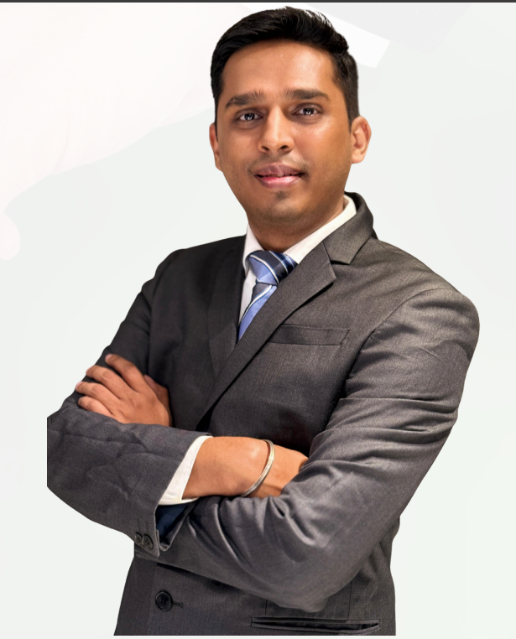
LEADERSHIP
Shrenik Shah
Managing Partner, Kalviro Ventures LLP
NISM V-A
NISM XXI-A
ARN-335497
APRN-06567
15 years in investment distribution. MBA, Cardiff Metropolitan University (UK). Dual NISM certifications across Mutual Fund Distribution and Portfolio Management Services.
FOCUS
• PMS & AIF evaluation and due diligence
• GIFT City structures for NRI investors
• Private credit & multi-asset construction
• HNI & UHNI allocation frameworks
Kalviro Ventures · PMS, AIF & GIFT City
8 / 10

Slide 9
INVESTMENT PARTNER NETWORK
30+ Managers. One Rigorous Standard.
45+
30+
15+
GIFT
PMS Strategies
Partners
AIF Managers
City Funds
Enam PMS
Negen Capital
Helios
TIW Capital
Phillip Capital
Motilal Oswal
Alchemy Capital
Carnelian
Ampersand Capital
Buoyant Capital
ICICI Pru Alt.
Neo AMC
Nippon India PMS
360 ONE
ASK
Abakkus
WhiteOak Capital
Aditya Birla Capital
Vivriti
Tata PMS
InCred
Sundaram Alternates
Renaissance
TCG
Kalviro Ventures · PMS, AIF & GIFT City
9 / 10

Slide 10
Let's have a conversation
worth having.
For HNI, UHNI, NRI and Family Office investors allocating to PMS, AIF or GIFT City.
Schedule a Conversation →
WhatsApp →
Phone
Email
Website
Office
+91-78100-08444
info@kalviroventures.com
www.kalviroventures.com
No 1 Cooks Road, SPR City,
A-2904, Chennai – 600012
AMFI ARN-335497 · APMI APRN-06567 · Startup India · MSME
Investments in securities markets are subject to market risks. Read all related documents carefully. Past performance is not indicative of future results. Kalviro Ventures LLP — AMFI ARN-335497 · APMI APRN-06567.
Kalviro Ventures · PMS, AIF & GIFT City
10 / 10

