Slide 1

Where
Conviction
Meets
Capital.
Curated access across
Mutual Funds
Curated schemes across 50+ AMC partnerships
Portfolio Management
India's leading PMS strategies, selected for conviction
Alternative Funds
Category I, II & III structures for serious portfolios
GIFT City
PMS, AIF & GIFT City Investments
One Curated Platform for Serious Capital
USD-denominated India access for NRI investors

Slide 2
THE LANDSCAPE
The landscape of Indian wealth
has everything. What's rare
is curation.
01
02
03
The universe has expanded.
Most relationships are transactional.
Accountability is diffuse.
India now has over 50 PMS strategies, 1,000+ AIF schemes and mutual fund options across every category. The challenge for investors with serious capital is no longer access — it is signal.
The intermediary ecosystem is built for volume. The result: investors receive recommendations calibrated to what is available, not what is appropriate. The portfolio bears the cost.
PMS, AIFs, mutual funds and GIFT City allocations often sit across four separate relationships. No single person sees the whole portfolio or answers for it entirely.
Most platforms give you access. Kalviro gives you a standard — and one relationship accountable for every allocation.

Slide 3
ABOUT US
About Kalviro Ventures
Who
We Are
Kalviro Ventures is a Chennai-based investment access platform built for investors who take capital allocation seriously. We provide curated access to Mutual Funds, PMS, AIFs and GIFT City structures — fewer strategies, higher conviction, one accountable relationship.
The Name
Kalviro
Registration
AMFI & APMI Registered · DPIIT Recognised Startup
Kalviro is rooted in Kalpavriksha — the wish-fulfilling tree that ancient texts describe as a source of enduring abundance — combined with Viro, the Sanskrit root for strength. It reflects a simple conviction: capital built on strong fundamentals and selective judgment outlasts capital built on market timing.
We believe wealth should grow thoughtfully — guided by discipline, strong fundamentals, and a long-term perspective.
Asset Classes
Mutual Funds · PMS · AIF · GIFT City
Clientele
HNI · UHNI · NRI · Family Offices
Approach
Conviction-led curation. Fewer strategies. Better outcomes.
Chennai, India · Founded 2025
DPIIT Recognised Startup · Registered MSME
Chennai, India
Founded 2025 · Registered MSME

Slide 4

INVESTMENT ACCESS
Four Asset Classes.
One Curated Relationship.
01
02
03
04
Mutual Funds
Portfolio Management
Services
Alternative Investment
Funds
GIFT City &
Global Structures
Foundation of every serious portfolio
India's leading equity minds, selected for conviction
Access beyond what public markets offer
India for global capital — and NRI investors
Curated schemes from 50+ AMC partnerships
Equity, debt and multi-asset strategies
Category I, II and III structures
USD-denominated, tax-efficient fund structures
Goal and horizon-aligned fund selection
50+ managers evaluated — select few on platform
Private credit, real assets, long-short
Designed for NRI investors seeking India exposure
Systematic and lump sum investment routes
Holding-level transparency and regular reporting
Illiquidity premium and portfolio diversification
Lower entry threshold than domestic AIF route
Equity, debt, hybrid and international categories
Separately managed, individually owned
Access to SEBI-registered AIF managers
Offshore access to India-focused strategies
Starts ₹500 SIP
Minimum ₹50 Lakh
Minimum ₹1 Crore
Minimum USD 1,50,000

Slide 5
OUR STANDARD
The Conviction Filter
The question behind every strategy we consider:
"Would we allocate to this in a patient,
long-term portfolio — knowing everything
about the structure, the risk, the manager?"
If the answer is not an unambiguous yes — the strategy does not reach our clients.
Selectivity
— We've said no to more strategies than most platforms have ever listed.
Accountability
— Every strategy is independently reviewed before it reaches a client.
Long-term horizon
— We evaluate for 5–10-year relevance, not the next quarterly cycle.
No surprises
— If we cannot explain exactly why a strategy belongs in your portfolio, it does not.

Slide 6
DIFFERENTIATION
What Makes This Different
01
02
03
Access without curation is noise.
NRI access at a materially lower threshold.
Built on research, not referrals.
We do not list every available strategy. Only those that have passed our internal conviction review are presented — making the signal materially cleaner.
GIFT City structures from USD 1,50,000 — versus the domestic AIF minimum of ₹1 crore. The same quality of India-focused strategies, at a significantly lower entry point.
Every client relationship originates from trust in the quality of our perspective. We did not build a distribution network — we built a point of view.
04
05
06
One relationship across all four asset classes.
Registered where it matters.
Founder-led. No delegation.
Mutual Funds, PMS, AIFs and GIFT City through a single accountable relationship — with consolidated visibility across everything you hold.
We hold ourselves to the standards serious investors expect. Every engagement is governed by regulatory compliance, fiduciary intent, and the discipline of a founder who has put his name on every recommendation made.
Shrenik Shah reviews every strategy personally before it reaches a client. There are no junior relationship managers. The judgement is not outsourced.

Slide 7
CLIENTELE
We work with a focused number
of investors. By design.
01
02
03
04
HNI Investors
UHNI Investors
NRI Investors
Family Offices
₹50 Lakh and above
₹5 Crore and above
Non-Resident Indians
Multi-generational Capital
Investors moving beyond mutual funds into PMS and AIFs — seeking a structured, research-backed approach across a broader set of asset classes.
Portfolios requiring institutional-grade access across all four asset classes, with consolidated visibility and a single relationship accountable for the whole.
India exposure through NRE/NRO routes and GIFT City USD structures — access to India's leading PMS and AIF managers from anywhere in the world.
Families requiring consolidated reporting, succession-aligned frameworks and disciplined access across mutual funds, PMS, AIF and GIFT City in one relationship.
PMS ₹50L · AIF ₹1Cr
All four classes · Bespoke allocation
GIFT City from USD 1,50,000
Bespoke · All structures
Every client relationship at Kalviro Ventures is managed with personal accountability — no handoffs, no delegation of judgement.

Slide 8
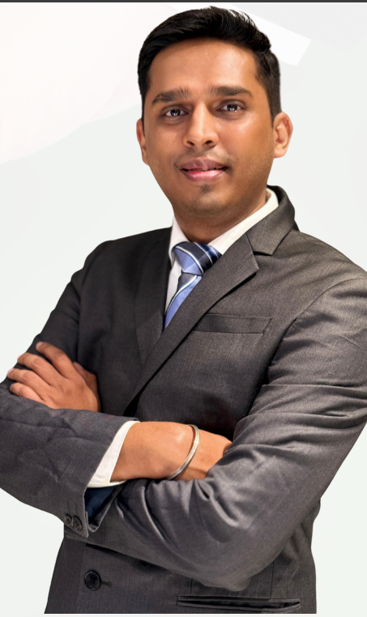
LEADERSHIP
Shrenik Shah
Managing Partner, Kalviro Ventures LLP
NISM Series V-A
NISM Series XXI-A
Research-Led
MBA
Cardiff Metropolitan University, UK
Shrenik Shah brings deep expertise across investment research, wealth distribution and multi-asset portfolio construction. His approach is research-first — every strategy on the Kalviro platform has been personally evaluated by him before reaching a client.
His conviction: that the quality of access matters more than the breadth of choice. The right strategy, in the right structure, is the foundation of enduring wealth.
Areas of Focus
PMS & AIF strategy evaluation and due diligence
GIFT City structures for NRI investors
Fixed income and private credit
HNI & UHNI multi-asset portfolio construction
Mutual fund portfolio advisory
"The most important thing we do is say no. To strategies that don't belong. That discipline is what makes every yes worth something."

Slide 9

INVESTMENT PARTNER NETWORK
50+
20+
15+
30+ Managers. One Rigorous Standard.
AMC
Partners
PMS
Managers
AIF
Managers
Motilal Oswal
Alchemy Capital
Carnelian Asset Mgmt
Ampersand Capital
Buoyant Capital
ICICI Prudential Alt.
Neo Asset Management
Nippon India PMS
360 ONE
ASK Investment Mgrs
Invesco
Axis AMC
Renaissance Inv.
Abakkus Asset Mgmt
WhiteOak Capital
Aditya Birla Capital
Vivriti Asset Mgmt
Swoym Advisors
Finavenue
Tata PMS
InCred Asset Mgmt
Tcg Asset Management
Negen Capital
Sundaram Alternates
And many more...

Slide 10



Get in Touch
Let's have a
conversation
worth having.
Phone & WhatsApp
+91-7810008444
Email
info@kalviroventures.com
If you are an HNI, UHNI, NRI or Family Office investor, we would welcome an introduction. The conversation starts with what you are trying to build — not with a product.
Website
www.kalviroventures.com
Schedule a Conversation →
AMFI Registered · ARN-335497
APMI Registered · APRN06567
DPIIT Recognised Startup · Registered MSME

